Slide 1


Video Games
Analysis on video games sales

Slide 2

Introduction
Steam is an online platform from game developer Valve
Where you can buy, play, create, and discuss PC games.
The platform hosts thousands of games (as well as downloadable content, or DLC, and user-generated features called "mods") from major developers and indie game designers alike.

Slide 3
Agenda
To make recommendation on the video games based on
Types of Genre
Game Critic and User Score
Relevant gaming platforms
Top ranking video games
Identifying Top Publishers/Developers

Slide 4
Genre
Action, Sports, Shooter, Role-Playing and Platform are the top 5 Genre, when it comes to sales.
When comparing with average sale, Platform, Shooter, Role-Playing, Racing and Sports are the top 5.
Sports, Shooter, Role-Playing and Platform are performing well in both total and average sale.

Slide 5
Game Critic and User Score
Role-playing, sports and shooter genres score well on critic score among the top genre sale.
Where role-playing, platform and fighting score well on user score.
The top 3 genre in total sale did not score well in user score.

Slide 6
Total Sales By Platform

Slide 7
Platform Generation
We are here
There are a good increase in gaming platforms after Gen 4.
There is a steady increase of sales as the platform generation evolves.
Gen 7 has the highest amount of sales generated.
Gen 3 has the highest average sales for video games.
Video game are getting more affordable after Gen 4.

Slide 10
List Of Top 30 Games
Genre | Gametitle | Publisher | Platform | TotalSale
Sports | Wii Sports | Nintendo | Wii | 82.53
Platform | Super Mario Bros. | Nintendo | NES | 40.24
Racing | Mario Kart Wii | Nintendo | Wii | 35.52
Sports | Wii Sports Resort | Nintendo | Wii | 32.77
Role-Playing | Pokemon Red/Pokemon Blue | Nintendo | GB | 31.37
Puzzle | Tetris | Nintendo | GB | 30.26
Platform | New Super Mario Bros. | Nintendo | DS | 29.8
Misc | Wii Play | Nintendo | Wii | 28.92
Platform | New Super Mario Bros. Wii | Nintendo | Wii | 28.32
Shooter | Duck Hunt | Nintendo | NES | 28.31
Simulation | Nintendogs | Nintendo | DS | 24.67
Racing | Mario Kart DS | Nintendo | DS | 23.21
Role-Playing | Pokemon Gold/Pokemon Silver | Nintendo | GB | 23.1
Sports | Wii Fit | Nintendo | Wii | 22.7
Misc | Kinect Adventures! | Microsoft Game Studios | X360 | 21.81
Sports | Wii Fit Plus | Nintendo | Wii | 21.79
Action | Grand Theft Auto V | Take-Two Interactive | PS3 | 21.04
Action | Grand Theft Auto: San Andreas | Take-Two Interactive | PS2 | 20.81
Platform | Super Mario World | Nintendo | SNES | 20.61
Misc | Brain Age: Train Your Brain in Minutes a Day | Nintendo | DS | 20.15
Role-Playing | Pokemon Diamond/Pokemon Pearl | Nintendo | DS | 18.25
Platform | Super Mario Land | Nintendo | GB | 18.14
Platform | Super Mario Bros. 3 | Nintendo | NES | 17.28
Action | Grand Theft Auto V | Take-Two Interactive | X360 | 16.27
Action | Grand Theft Auto: Vice City | Take-Two Interactive | PS2 | 16.15
Role-Playing | Pokemon Ruby/Pokemon Sapphire | Nintendo | GBA | 15.85
Puzzle | Brain Age 2: More Training in Minutes a Day | Nintendo | DS | 15.29
Role-Playing | Pokemon Black/Pokemon White | Nintendo | DS | 15.14
Racing | Gran Turismo 3: A-Spec | Sony Computer Entertainment | PS2 | 14.98
Shooter | Call of Duty: Modern Warfare 3 | Activision | X360 | 14.73

Slide 11
Top 30 Games

Slide 12
List Of Top 10 Games Based On Genre
Genre | Gametitle | Publisher | TotalSale
Action | Grand Theft Auto V | Take-Two Interactive | 56.57
Action | Grand Theft Auto: San Andreas | Take-Two Interactive | 23.84
Action | Grand Theft Auto IV | Take-Two Interactive | 22.39
Action | Grand Theft Auto: Vice City | Take-Two Interactive | 16.19
Action | FIFA Soccer 13 | Electronic Arts | 15.96
Action | LEGO Star Wars: The Complete Saga | LucasArts | 15.26
Action | LEGO Batman: The Videogame | Warner Bros. Interactive Entertainment | 13.39
Action | Grand Theft Auto III | Take-Two Interactive | 13.11
Action | Assassin's Creed III | Ubisoft | 13.02
Action | Assassin's Creed IV: Black Flag | Ubisoft | 13.02
Adventure | Assassin's Creed | Ubisoft | 11.27
Adventure | Super Mario Land 2: 6 Golden Coins | Nintendo | 11.18
Adventure | L.A. Noire | Take-Two Interactive | 5.87
Adventure | Zelda II: The Adventure of Link | Nintendo | 4.38
Adventure | Rugrats: Search For Reptar | THQ | 3.34
Adventure | Club Penguin: Elite Penguin Force | Disney Interactive Studios | 3.14
Adventure | Heavy Rain | Sony Computer Entertainment | 3.03
Adventure | Minecraft: Story Mode | Mojang | 2.91
Adventure | Myst | Red Orb | 2.81
Adventure | Rise of the Tomb Raider | Square Enix | 2.76
Fighting | Super Smash Bros. Brawl | Nintendo | 12.84
Fighting | Super Smash Bros. for Wii U and 3DS | Nintendo | 12.42
Fighting | WWE SmackDown vs Raw 2008 | THQ | 7.39
Fighting | Street Fighter IV | Capcom | 7.23
Fighting | Tekken 3 | Sony Computer Entertainment | 7.16
Fighting | Super Smash Bros. Melee | Nintendo | 7.07
Fighting | Street Fighter II: The World Warrior | Capcom | 6.3
Fighting | Tekken 2 | Sony Computer Entertainment | 5.74
Fighting | Mortal Kombat | Warner Bros. Interactive Entertainment | 5.59
Fighting | Fight Night Round 3 | Electronic Arts | 5.55
Misc | Wii Play | Nintendo | 28.92
Misc | Kinect Adventures! | Microsoft Game Studios | 21.81
Misc | Brain Age: Train Your Brain in Minutes a Day | Nintendo | 20.15
Misc | Guitar Hero III: Legends of Rock | Activision | 16.35
Misc | Just Dance 3 | Ubisoft | 12.76
Misc | Minecraft | Microsoft Game Studios | 12.62
Misc | Guitar Hero: World Tour | Activision | 10
Misc | Just Dance 2 | Ubisoft | 9.44
Misc | Mario Party DS | Nintendo | 8.91
Misc | Just Dance 4 | Ubisoft | 8.74
Platform | Super Mario Bros. | Nintendo | 45.31
Platform | New Super Mario Bros. | Nintendo | 29.8
Platform | New Super Mario Bros. Wii | Nintendo | 28.32
Platform | Super Mario World | Nintendo | 26.07
Platform | Super Mario Bros. 3 | Nintendo | 22.48
Platform | Super Mario 64 | Nintendo | 22.19
Platform | Super Mario Land | Nintendo | 18.14
Platform | Donkey Kong Country | Nintendo | 13.53
Platform | Super Mario Galaxy | Nintendo | 11.35
Platform | Super Mario 3D Land | Nintendo | 10.81
Puzzle | Tetris | Nintendo | 35.84
Puzzle | Brain Age 2: More Training in Minutes a Day | Nintendo | 15.29
Puzzle | Dr. Mario | Nintendo | 10.19
Puzzle | Pac-Man | Atari | 7.81
Puzzle | Professor Layton and the Curious Village | Nintendo | 5.19
Puzzle | Tetris Worlds | THQ | 4.01
Puzzle | Professor Layton and the Diabolical Box | Nintendo | 3.94
Puzzle | Professor Layton and the Unwound Future | Nintendo | 3.26
Puzzle | Pac-Man Collection | Atari | 2.94
Puzzle | WarioWare: Smooth Moves | Nintendo | 2.89
Genre | Gametitle | Publisher | TotalSale
Racing | Mario Kart Wii | Nintendo | 35.52
Racing | Mario Kart DS | Nintendo | 23.21
Racing | Gran Turismo 3: A-Spec | Sony Computer Entertainment | 14.98
Racing | Need for Speed: Most Wanted | Electronic Arts | 13.77
Racing | Mario Kart 7 | Nintendo | 12.66
Racing | Gran Turismo 4 | Sony Computer Entertainment | 11.66
Racing | Need for Speed Underground 2 | Electronic Arts | 10.95
Racing | Gran Turismo | Sony Computer Entertainment | 10.95
Racing | Gran Turismo 5 | Sony Computer Entertainment | 10.7
Racing | Need for Speed Underground | Electronic Arts | 10.46
Role-Playing | Pokemon Red/Pokemon Blue | Nintendo | 31.37
Role-Playing | Pokemon Gold/Pokemon Silver | Nintendo | 23.1
Role-Playing | The Elder Scrolls V: Skyrim | Bethesda Softworks | 21.15
Role-Playing | Pokemon Diamond/Pokemon Pearl | Nintendo | 18.25
Role-Playing | Pokemon Ruby/Pokemon Sapphire | Nintendo | 15.85
Role-Playing | Pokemon Black/Pokemon White | Nintendo | 15.14
Role-Playing | PokÃ©mon Yellow: Special Pikachu Edition | Nintendo | 14.64
Role-Playing | Pokemon X/Pokemon Y | Nintendo | 14.6
Role-Playing | Fallout 4 | Bethesda Softworks | 12.67
Role-Playing | Pokemon Omega Ruby/Pokemon Alpha Sapphire | Nintendo | 11.68
Shooter | Call of Duty: Black Ops | Activision | 30.82
Shooter | Call of Duty: Modern Warfare 3 | Activision | 30.59
Shooter | Call of Duty: Black Ops II | Activision | 29.4
Shooter | Duck Hunt | Nintendo | 28.31
Shooter | Call of Duty: Ghosts | Activision | 27.4
Shooter | Call of Duty: Black Ops 3 | Activision | 25.68
Shooter | Call of Duty: Modern Warfare 2 | Activision | 24.95
Shooter | Call of Duty: Advanced Warfare | Activision | 21.99
Shooter | Call of Duty 4: Modern Warfare | Activision | 18.19
Shooter | Battlefield 3 | Electronic Arts | 17.27
Simulation | Nintendogs | Nintendo | 24.67
Simulation | The Sims 3 | Electronic Arts | 15.07
Simulation | Animal Crossing: Wild World | Nintendo | 12.13
Simulation | Animal Crossing: New Leaf | Nintendo | 9.16
Simulation | Cooking Mama | 505 Games | 5.63
Simulation | MySims | Electronic Arts | 5.34
Simulation | Tomodachi Life | Nintendo | 5.23
Simulation | Microsoft Flight Simulator | Microsoft Game Studios | 5.12
Simulation | The Sims: Bustin' Out | Electronic Arts | 4.98
Simulation | Animal Crossing: City Folk | Nintendo | 4.62
Sports | Wii Sports | Nintendo | 82.53
Sports | Wii Sports Resort | Nintendo | 32.77
Sports | Wii Fit | Nintendo | 22.7
Sports | Wii Fit Plus | Nintendo | 21.79
Sports | FIFA 15 | Electronic Arts | 17.34
Sports | FIFA 14 | Electronic Arts | 16.48
Sports | FIFA 16 | Electronic Arts | 16.3
Sports | Mario & Sonic at the Olympic Games | Sega | 13.08
Sports | FIFA 12 | Electronic Arts | 13.06
Sports | FIFA Soccer 11 | Electronic Arts | 12.5
Strategy | Pokemon Stadium | Nintendo | 5.45
Strategy | Warzone 2100 | Eidos Interactive | 5.01
Strategy | StarCraft II: Wings of Liberty | Activision | 4.84
Strategy | Warcraft II: Tides of Darkness | Activision | 4.21
Strategy | PokÃ©mon Trading Card Game | Nintendo | 3.7
Strategy | Command & Conquer: Red Alert | Virgin Interactive | 3.26
Strategy | PokÃ©mon Stadium 2 | Nintendo | 2.73
Strategy | Sim Theme Park | Electronic Arts | 2.71
Strategy | Halo Wars | Microsoft Game Studios | 2.62
Strategy | Theme Hospital | Electronic Arts | 2.49

Slide 14
Publishers/Developers
Nintendo is ranked number 1 for publisher on both total sales and average sales for video games.
Electronic Arts is ranked number 2 on total sale, but it is due to volume of games published. Electronic Arts’ average sales on games is ranked slightly below average.
On active developers, US, Japan and England contribute the main bulk for the video games industries.

Slide 15
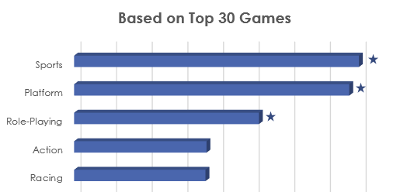
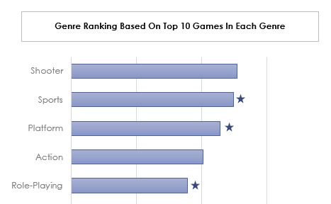
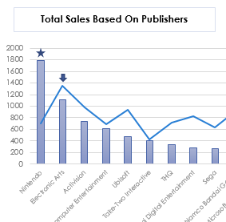
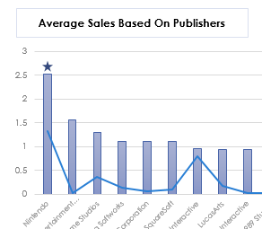
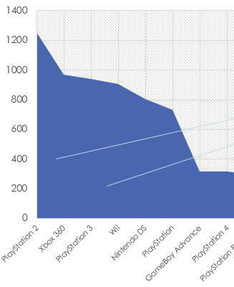
Recommendation
Genre
Sports, Shooter, Role-Playing and Platform
Perform well in both total and average sale.
Critic and User Score
Role-playing, fighting and strategy
Good review on both critic and user score
Genre : Role-playing
Publisher: Nintendo
Platforms: PlayStation/Xbox 360/Wii

Slide 16
Appendix
https://data.world/mhoangvslev/steam-games-dataset
https://www.commonsensemedia.org/blog/parents-ultimate-guide-to-steam#:~:text=is%20Steam%20Wallet%3F-,What%20is%20Steam%3F,and%20indie%20game%20designers%20alike.

Slide 17
Database Design and Application

Slide 18
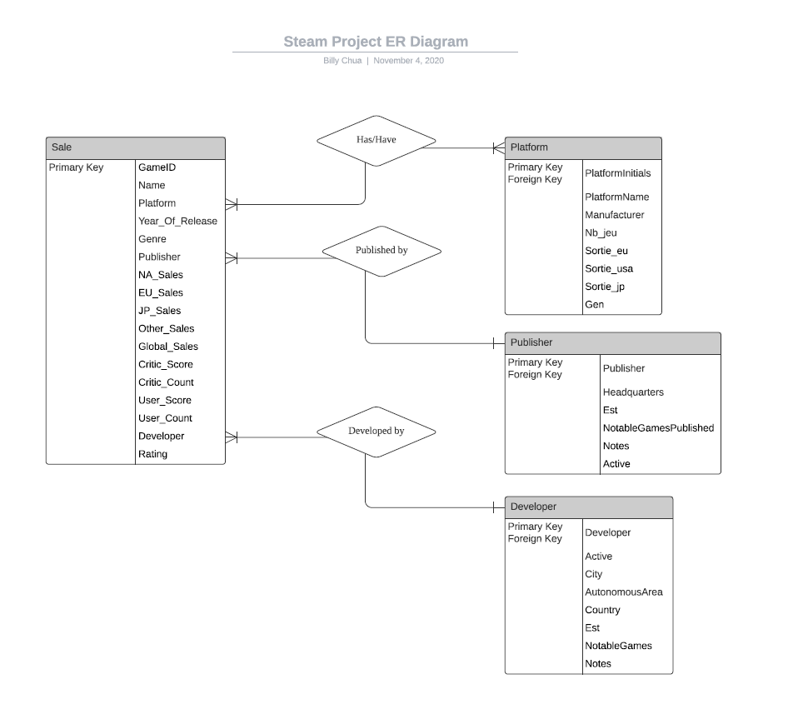

Slide 19
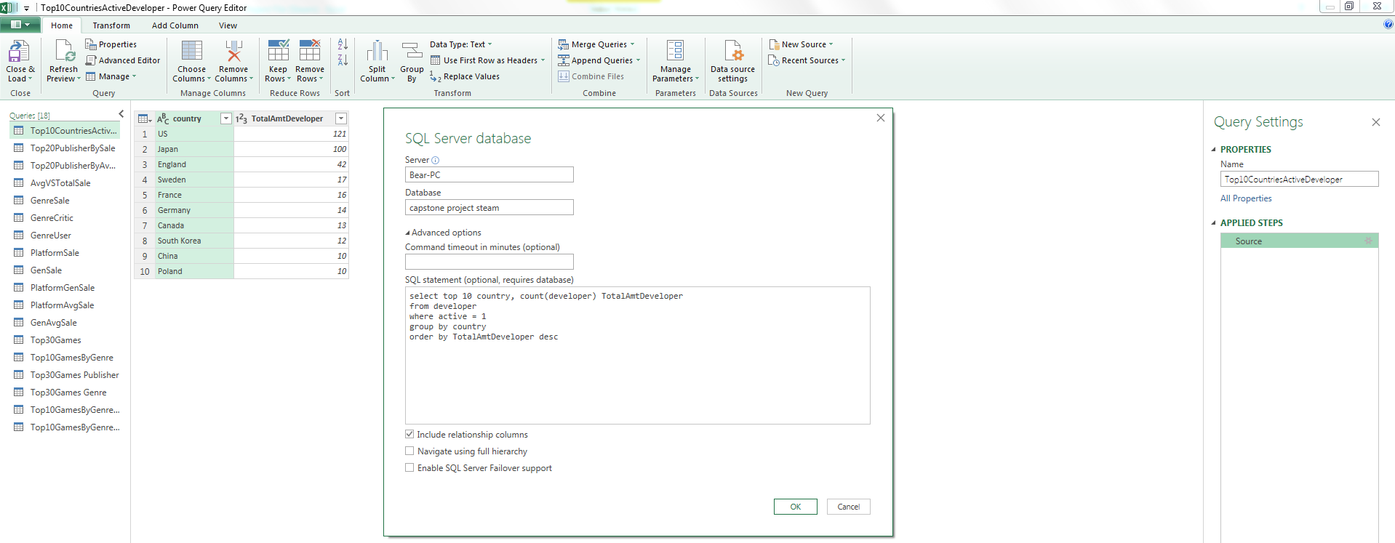
Using Excel/Power Query

Slide 20
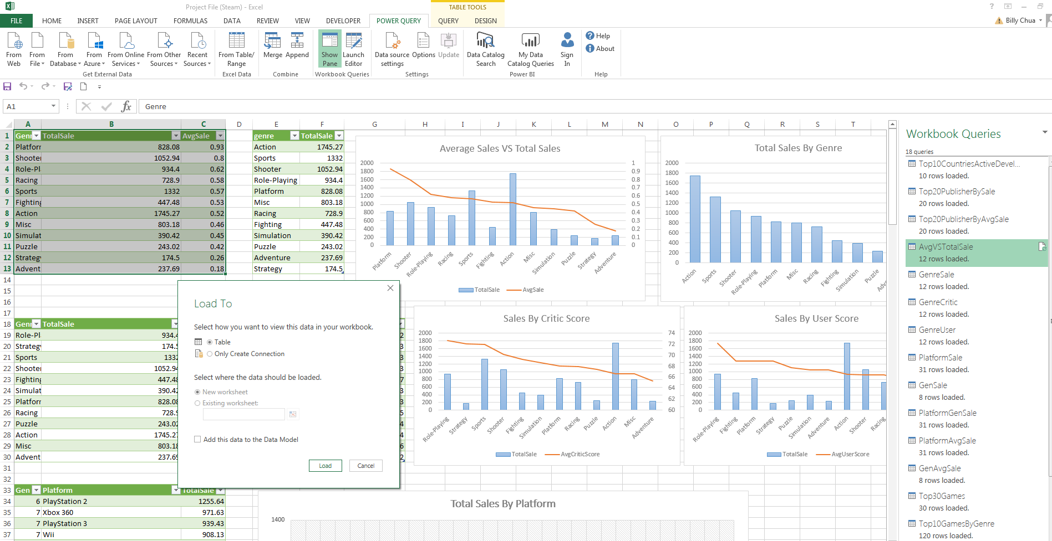
Using Excel/Power Query

Slide 21
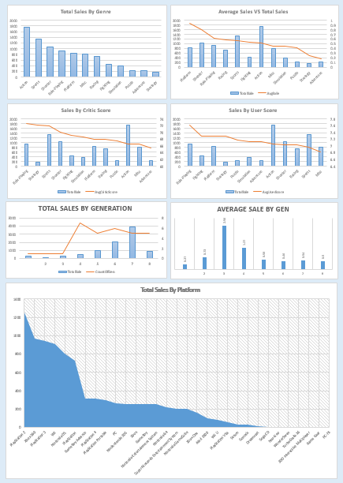
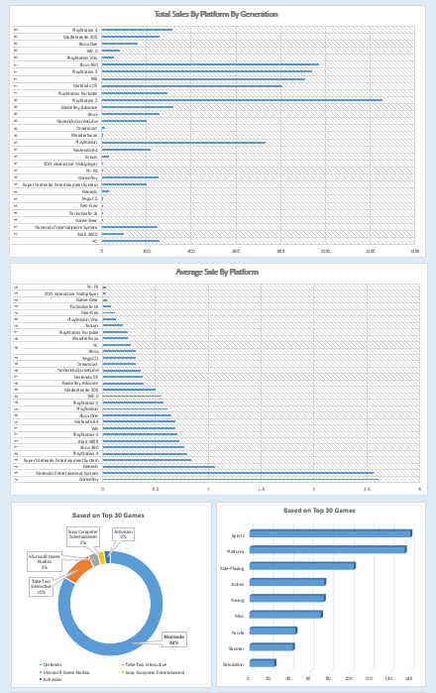
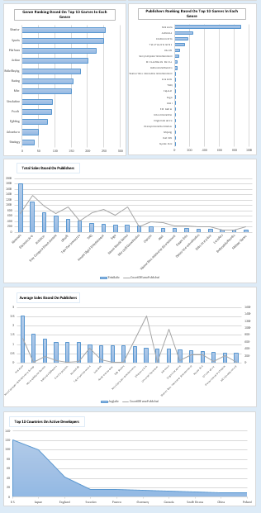
Using Excel On Building Dashboards

Slide 22
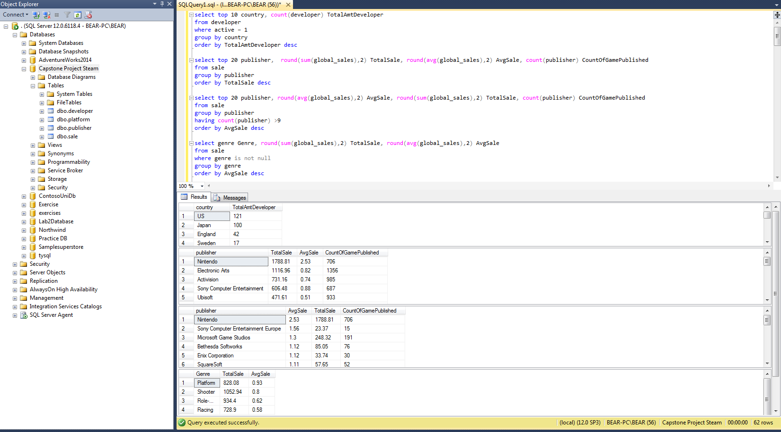

Slide 23
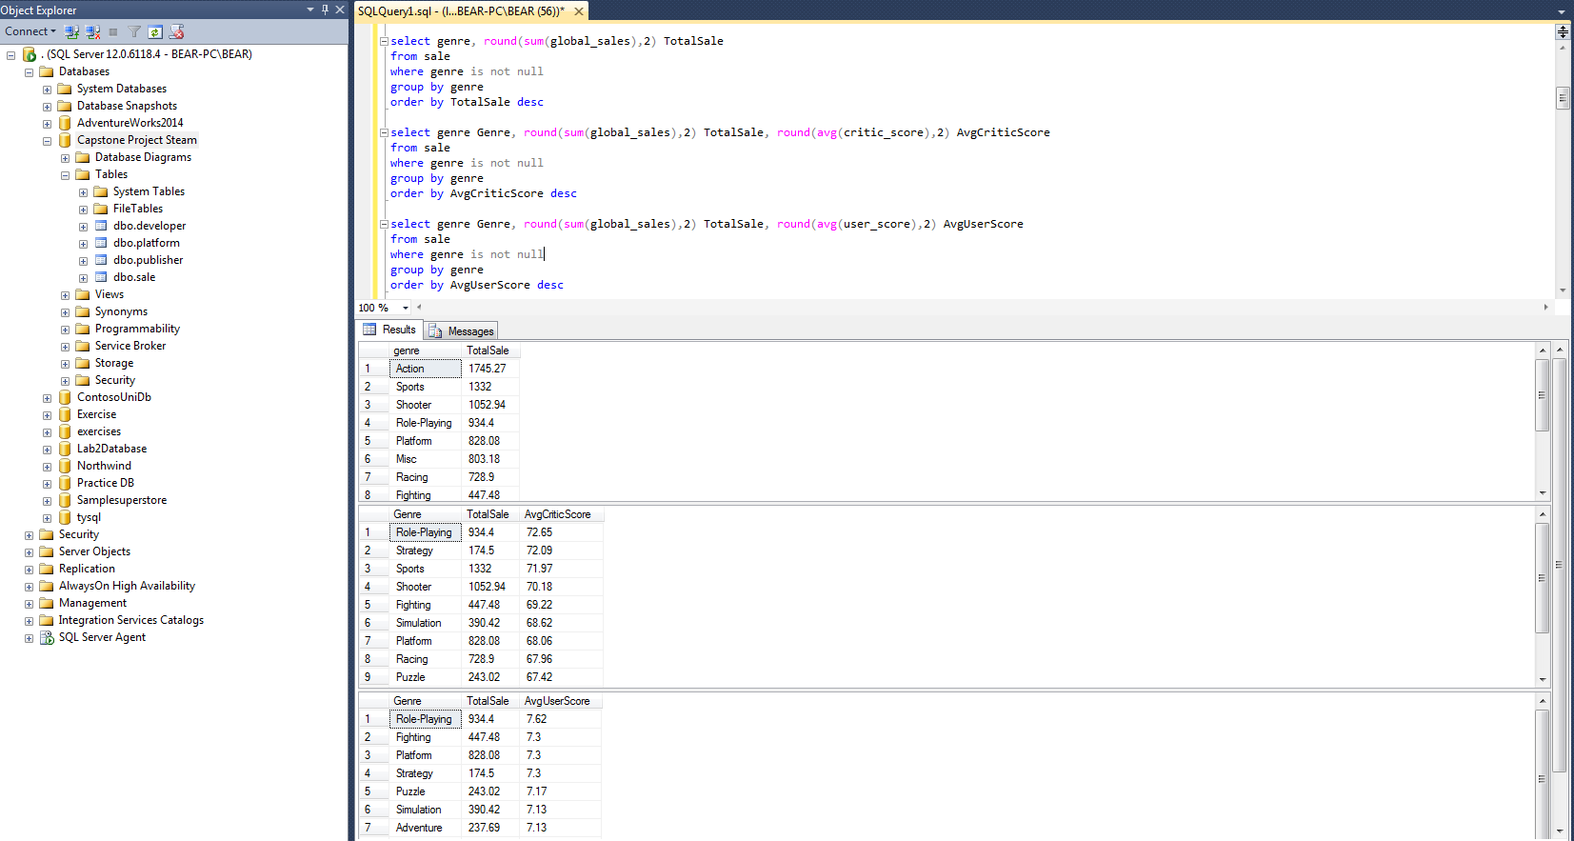

Slide 24
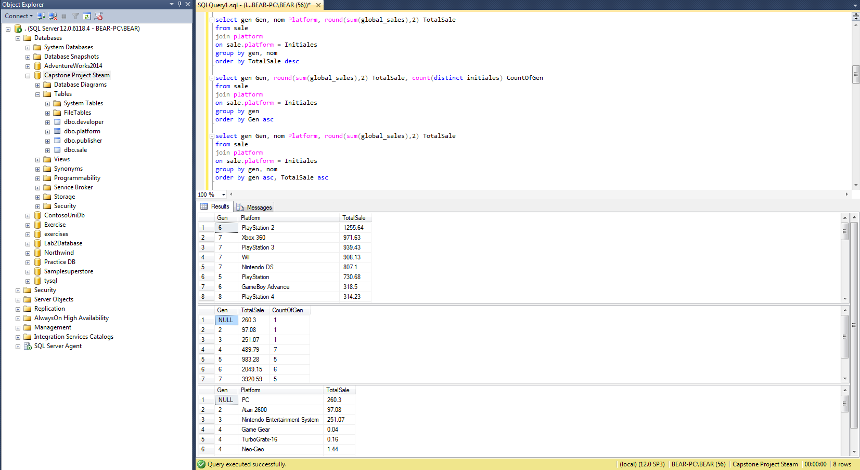

Slide 25
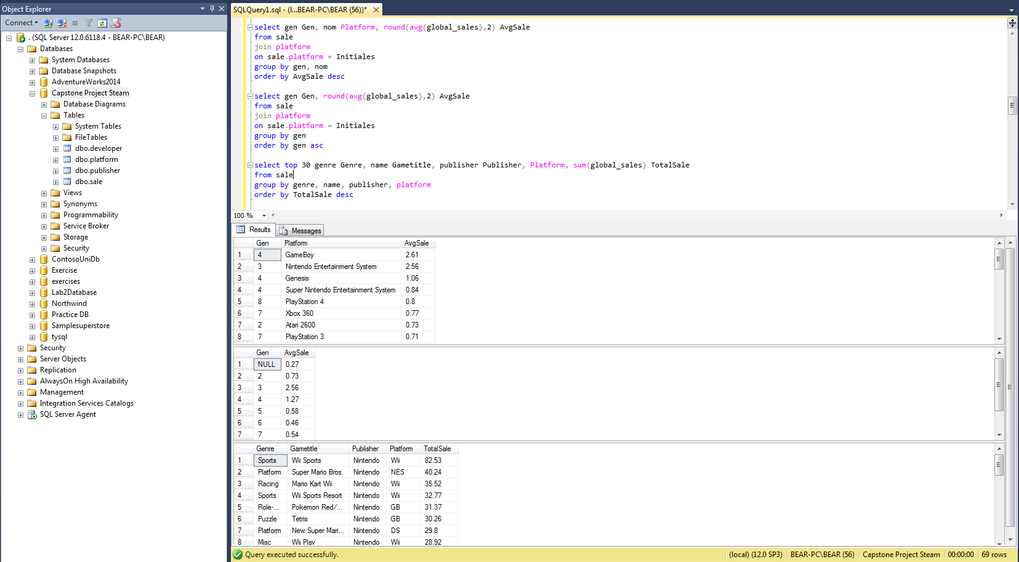

Slide 26
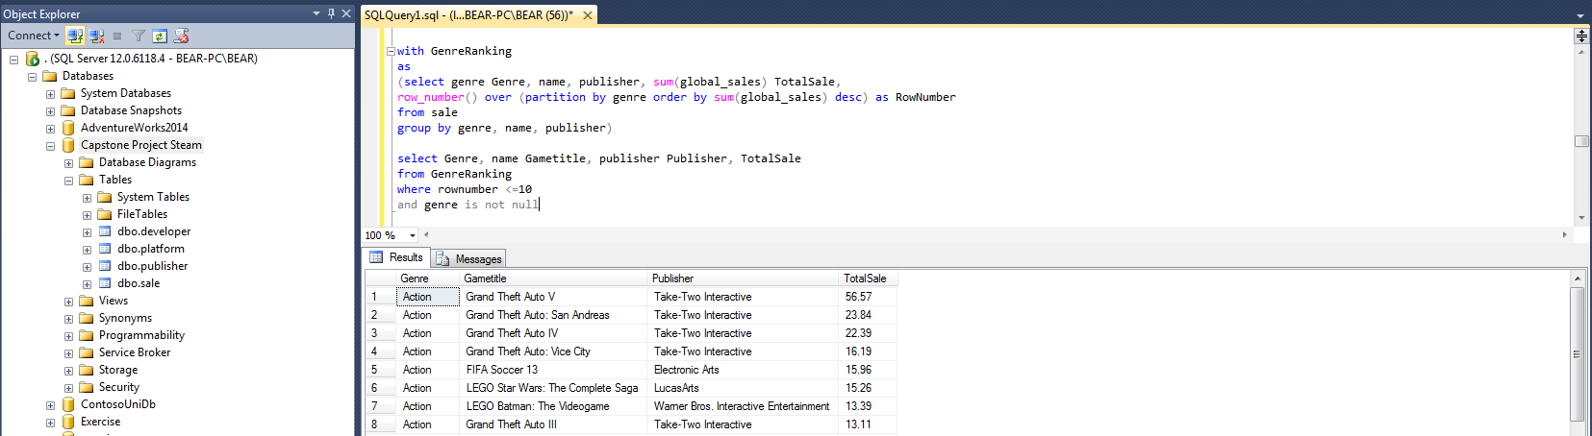
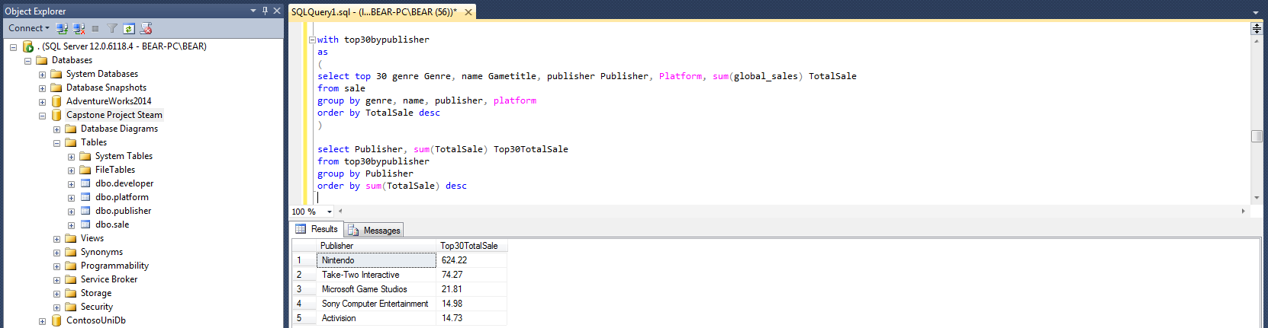

Slide 27
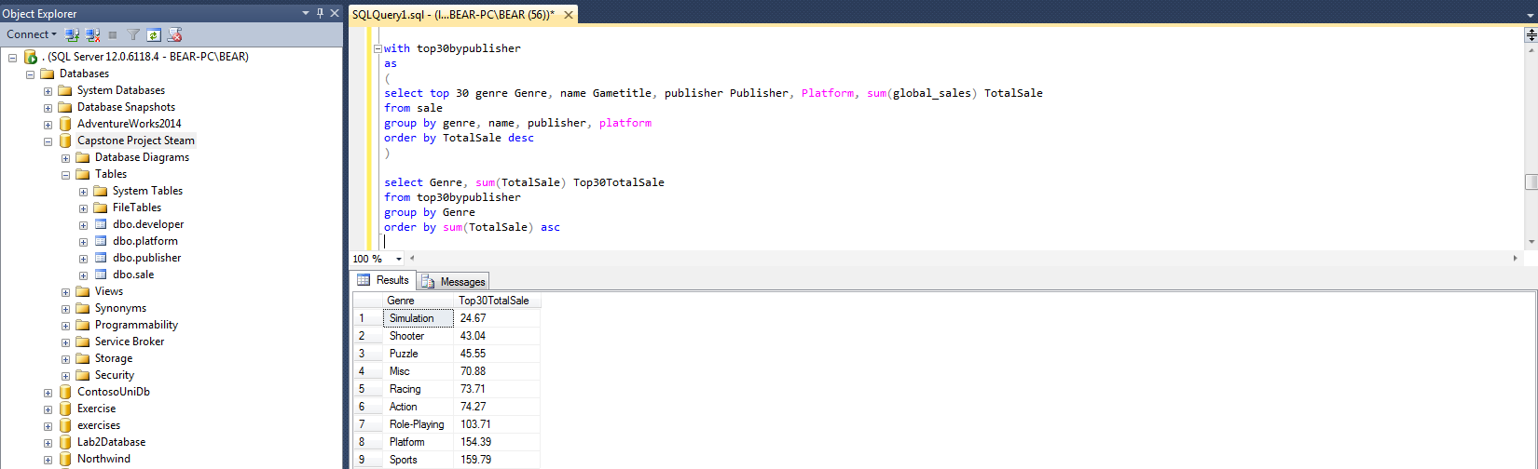
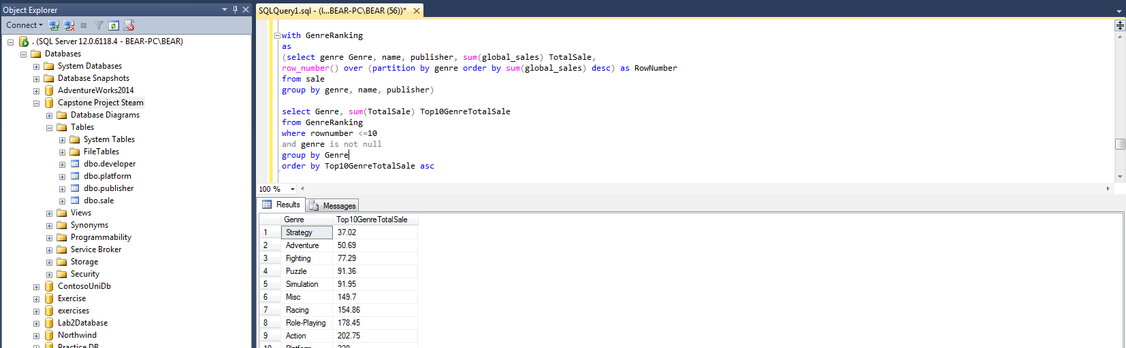

Slide 28
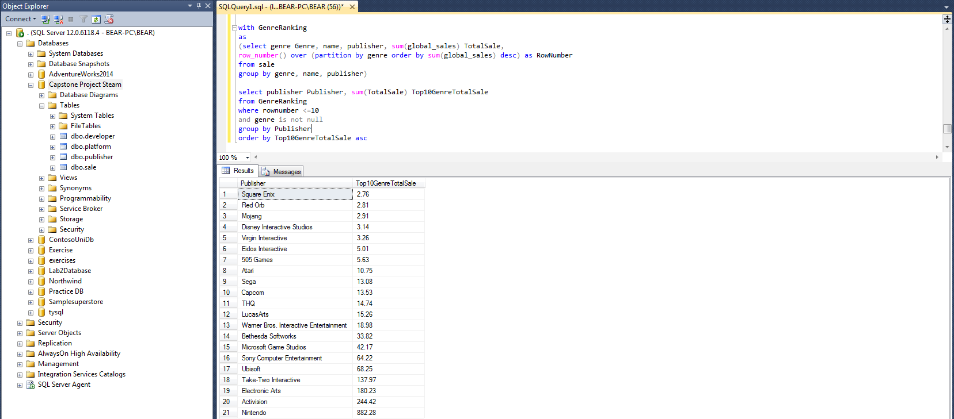

Slide 29
The End

